Slide 1

Recurrent Neural Networks
Gated Recurrent Unit (GRU)
deeplearning.ai

Slide 2
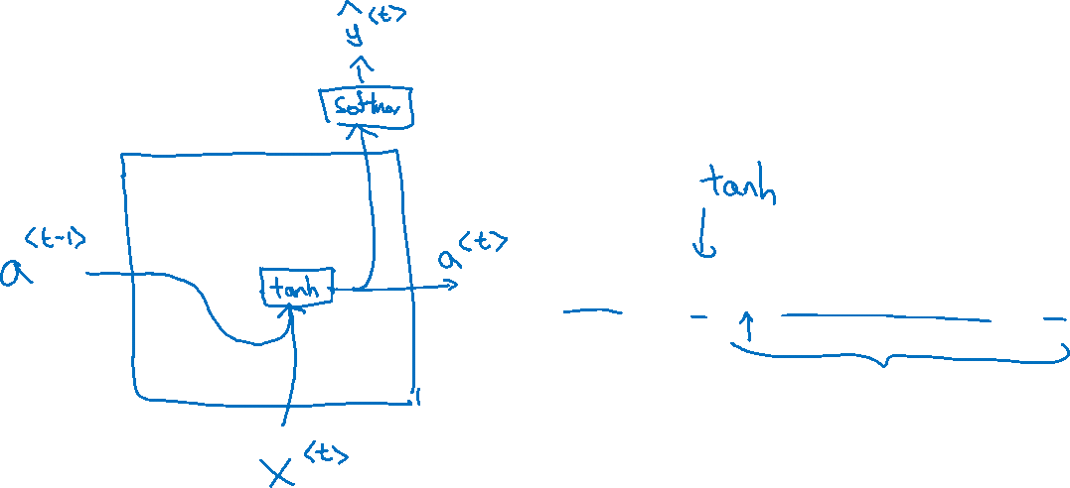




RNN unit
$$a^{<t>}=g(W_{a}\left[a^{<t−1>}, x^{<t>}\right]+b_{a})$$
$${\hat{y}}^{<1> }$$
$$a^{<0>}$$
$$a^{<1>}$$
$$x^{<1>}$$

Slide 3

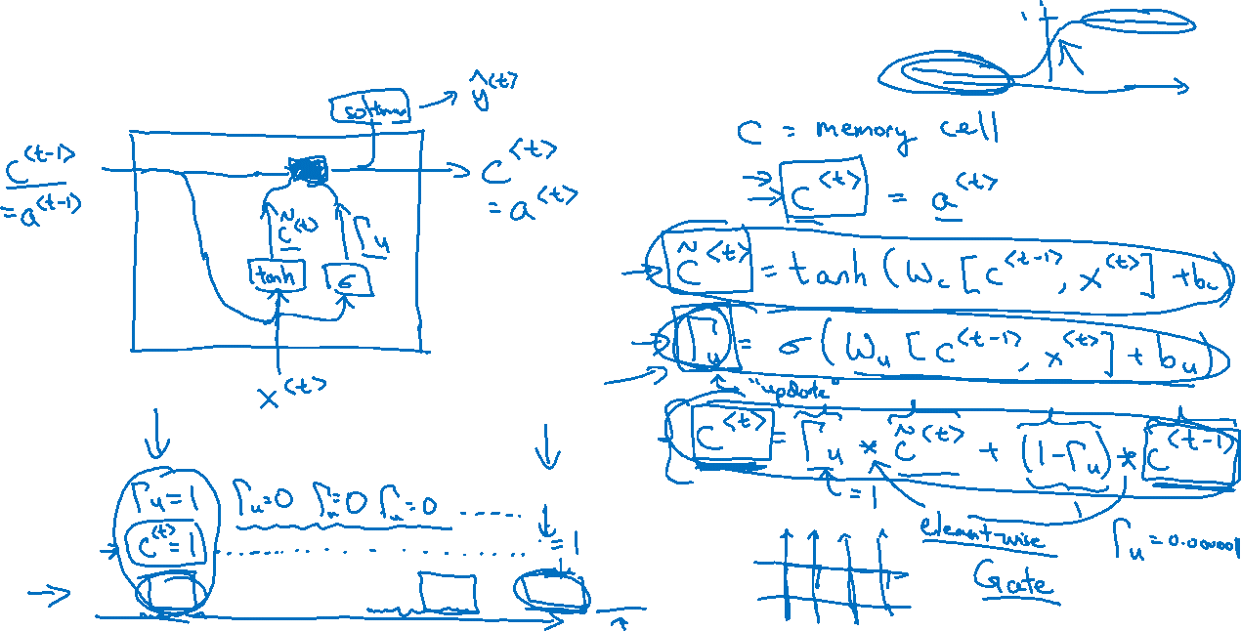
GRU (simplified)
The cat, which already ate …, was full.
[Cho et al., 2014. On the properties of neural machine translation: Encoder-decoder approaches]
[Chung et al., 2014. Empirical Evaluation of Gated Recurrent Neural Networks on Sequence Modeling]

Slide 4
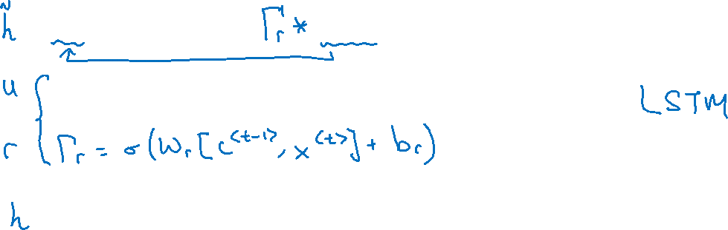


Full GRU
$${\tilde{c}}^{<t>}=\tanh{(W_{c}[}$$
$$c^{<t−1>},x^{<t>}]+b_{c})$$
Update gate，控制本单元对后续的影响，=1则相当于复制前一单元，将本单元短路
$$Γ_{u}=σ{(W_{u}\left[ c^{<t−1>},x^{<t>}\right]+b_{u})}$$
Reset gate，控制前一单元对本单元的影响，=0全部遗忘
$$c^{<t>}=Γ_{u}{∗{\tilde{c}}^{<t>}+\left(1−Γ_{u}\right)+c^{<t−1>}}$$
The cat, which ate already, was full.

